Slide 1


Loan Automation
Presented by,
Naga Sravani (2091351)
Shiva Praneeth (2091461)
Sruthi (1995568)

Slide 2
Outline / Agenda :
Introduction
Problem Space
Existing System
Proposed System
Technology used : Hardware Requirements
Technology used : Software Requirements
Technical Architecture
Module Architecture
Module – Administration 1
Module – Administration 2
Module – Pick up / verification
Module – Legal / customer
Task division of the team
Future Enhancements
Conclusion

Slide 3
Introduction
Loan automation is an interface which facilitates a customer to apply for a loan online and to track the status from time-to-time along with aiding the loan approval agency to verify and accept/reject the customer file.
Loan automation is a unique procedure. It not only helps customers but also helps the loan agency to check the pending transactions and assign it to the respective department, complete the formalities and procedures between the departments.
An individual can access and retrieve information from different locations as well as everything is operated virtually.

Slide 4
Problem space

Slide 5
Existing System
Usually, banking loans involve manual procedure where a bank agent connects with the customer in person and completes the formalities for applying a bank loan. Also, to check the status of the loan approval/denial customer will receive a confirmation via a message/email.
If customer has an emergency and there is a delay in the process, then it will lead to customer dis-satisfaction.
Current system is not efficient and effective.
There is a lack of good co-ordination between departments.

Slide 6
Proposed System
In the online automated system, customer can track all the details easily as this is user-friendly.
It provides effective forwarding system to move the file from one level to another.
This is a web-based architecture. It maintains information related to different departments and is stored in a central DB, which leads easy accessibility and consistency.
For authenticity, we ask customers to scan and upload digital passport size picture, signature(thrice) and submit all original documents.

Slide 7
Technology Used
HARDWARE REQUIREMENTS:
System : Pentium Dual Core
Hard Disk : 40 GB
Monitor : 15’’ LED
Input Devices : Keyboard, Mouse
Ram : 1 GB

Slide 8
Technology Used
SOFTWARE REQUIREMENTS:
Programming Language : Java
Web-based Technologies : JSP and JDBC
Database : MySQL
Server : Apache Tomcat 7.0
Web Presentation : HTML, CSS
IDE : Eclipse

Slide 9
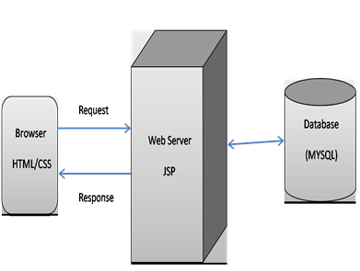
Technical Architecture

Slide 10
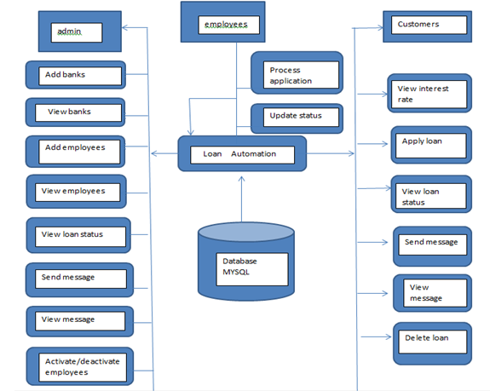
Module Architecture:

Slide 11
Module
Administrator Module:
This module is responsible for coordinating other modules.
It allows the administrator to create/update/delete and view the banks information.
It allows admin to create/update/delete and view different departments.
It can create logins for different employees in every department.

Slide 12
Administrator Module:
It can manage loan interest rates of different banks etc.
It facilitates to view the new applicant details and assign it to different employees in pickup department initially.
It provides messaging facility for the administrator for communication.

Slide 13
PickUp Module:
This module allows the pickup department to view their applications which are assigned to them, cross-check the documents according to the checklist and forward it to verification department.
Verification Module:
This module allows the employees of verification department to view the forwarded application from manager and check the details as per the documents and forward it to next level.

Slide 14
Legal Module:
This module allows the employee of legal department to verify all the documents of the customer legally and then generates approval.
Customer Module:
This module allows the customer to view the interest rates of the banks which we are dealing, apply for a loan, check the status of the loan at any point of time and communicate with the administrator if necessary. It allows messaging facility for communication.

Slide 15
Task Division of the team
Database will be taken care by : Shiva Praneeth
Java coding will be taken care by : Naga Sravani
Web Presentation will be taken care by : Sruthi

Slide 16
Future Enhancements
Add additional features to improve the performance and authenticity.
Include more secure ways to spread across larger medium.
Hearing feedback from customers based on reviews and people who are working on this.
Design our caching data access mechanism and state management considering times of intermittent connectivity.

Slide 17
Conclusion
Customer can apply for a loan and track his file details online.
The entire system is designed in such a way that all the information is accessible in a click of the mouse.
The decision process is faster and more consistent.
Provides a facility to generate the reports very easily.

Slide 18
Thank You!!

